Slide 1
PHP and MySQL Introduction​
Course Code:CSC 3215
Course Title: Web Technologies
Dept. of Computer Science
Faculty of Science and Technology
Lecturer No: | 07 | Week No: | 06 | Semester:
Lecturer: | Sazzad Hossain sazzad@aiub.edu

Slide 2
Lecture Outline
MySQL installation
phpMyAdmin Dashboard
Using phpMyAdmin

Slide 3
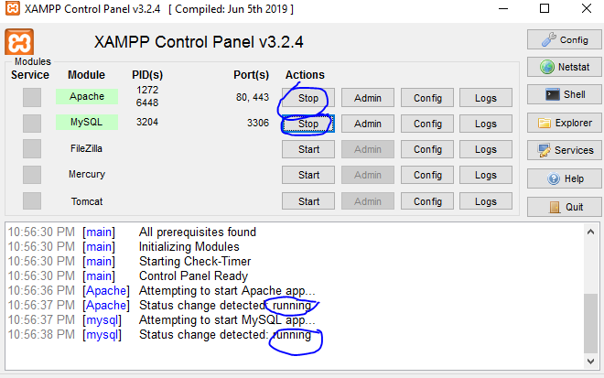
MySQL Installation
Open XAMPP control panel and make sure that Apache and MySQL service is running

Slide 4
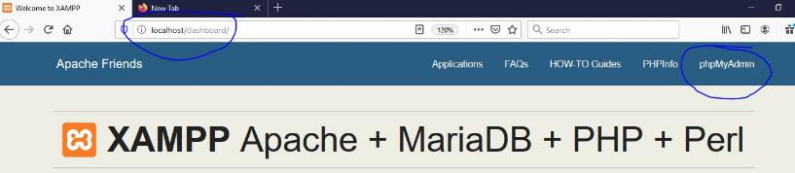
phpMyAdmin
Open a browser then type ‘localhost’ or ‘localhost:8080’ or ‘localhost:8082’
Then navigate to ‘phpMyAdmin’

Slide 5
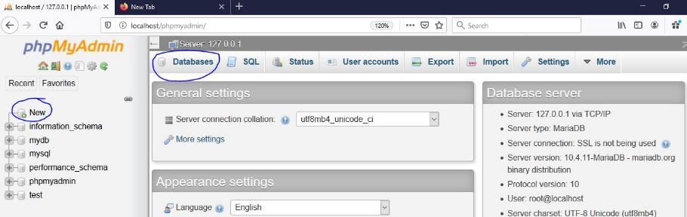
phpMyAdmin Dashboard
Below picure shows ‘phpMyAdmin’ dashboard
To check existing database, the user can click on ‘Databases’
User can create database by clicking ‘New’

Slide 6
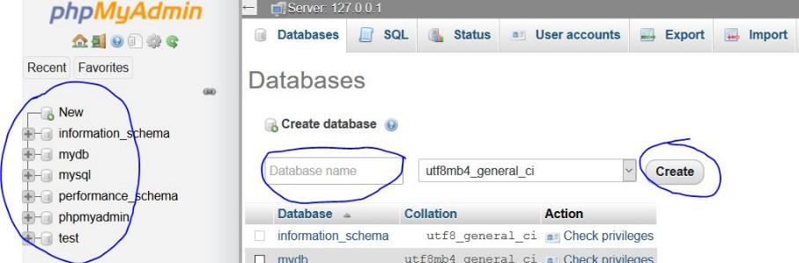
Create DB
User can create database by entering the database name click create button
If the database successfully created then it will appear on left menu.

Slide 7
Create DB
User can create database by entering the database name click create button
If the database successfully created then it will appear on left menu.

Slide 8
PHP and MySQL Connection
Create a php file and try out below code. If it returns "Connected successfully" then connection between PHP and MySQL is successful
<?php $servername = "localhost"; // default host name $username = “root"; // default user is root $password = ""; //default password is empty // Create connection using mysqli function $conn = new mysqli($servername, $username, $password); // Check connection if ($conn->connect_error) { die("Connection failed: " . $conn->connect_error); } echo "Connected successfully"; ?>

Slide 9
References
MySQL - www.mysql.com
W3Schools Online Web Tutorials- www.w3schools.com
PHP Manual - www.php.net

Slide 10
Books
Sams Teach Yourself Ajax JavaScript and PHP All in One; Phil Ballard and Michael Moncur;
Sams Publishing; 2010
JavaScript Phrasebook; Christian Wenz; Sams Publishing; 2007
PHP and MySQL Web Development, 4/E; Luke Welling and Laura Thomson; AddisonWesley Professional; 2009
JavaScript for Programmers Paul J. Deitel and Harvey M. Deitel; Prentice Hall; 2009

